Slide 1

QRT BOT
Group No. : 21
Department of CSE
Jyothi Engineering College
Thrissur
June 10, 2021

Slide 2
Group Members
Joshua Joseph JEC17CS059
Josin George JEC17CS060
Sangeetha C P JEC17CS086
Shilpa Sivadas JEC17CS093
Guide :
Mr. Unnikrishnan P (Assistant Professor)
GIT : https://github.com/ShilpaSivadas24/Group21_FinalProject

Slide 3
Vision of the Department
Creating eminent and ethical leaders in the domain of Computational Sciences through quality professional education with a focus on holistic learning and excellence.
Mission of the Department
To create technically competent and ethically conscious graduates in the field of Computer Science and Engineering by encouraging holistic learning and excellence.
To prepare students for careers in Industry, Academia and the Government.
To instill Entrepreneurial Orientation and research motivation among the students of the department.
To emerge as a leader in education in the region by encouraging teaching, learning, industry and societal connect.

Slide 4
Introduction
The COVID-19 global pandemic has produced a human and economic crisis unlike any recent memory
COVID-19 is killing people on a large scale
COVID-19 results in psychological issues due to both pandemic stress and the physical affects of the disease
Currently, there is a lot of misinformation and lack of awareness about COVID-19.

Slide 5
Objectives
Determine if a user has a high chance of being COVID-19 positive
Allow users to interact with a chatbot which further analyses the users’ emotion
Raise awareness among people regarding COVID-19.

Slide 6
Literature Survey
Medbot: Conversational artificial intelligence powered chatbot for delivering tele-health after covid-19
Advantage:
Available in many local dialects
Disadvantage:
Does not consider mental health
2. Chatbots in the fight against the COVID-19 pandemic
Advantage:
Provides factual information about Covid
Allows easy monitoring of symptoms
Disadvantage:
It only recommends the necessary precautions to be taken;does not predict

Slide 7
Literature Survey
3) Chatbot for Disease Prediction and Treatment Recommendation using Machine Learning
Advantage:
Alternative to the conventional method of visiting a hospital -making an appointment with a doctor to get diagnosis
Disadvantage:
Disease detection - less accurate
4)Compassion Driven Conversational Chatbot Aimed for better Mental Health
Advantage:
Entirely free and available 24x7
Disadvantage:
Currently text-based interface

Slide 8
Proposed System
A simple chatbot that effectively allow users to check if they have high chance of being Covid-19 positive and also provide health support / emotional support during quarantine.

Slide 9
Functional Requirements
User interface: The user interface module where the user needs to login.
Data Pre-processing and Feature extraction: User replies are taken as input from the chat.
Request analysis/Return response: The user is informed with preventive measures and other counter measures.

Slide 10
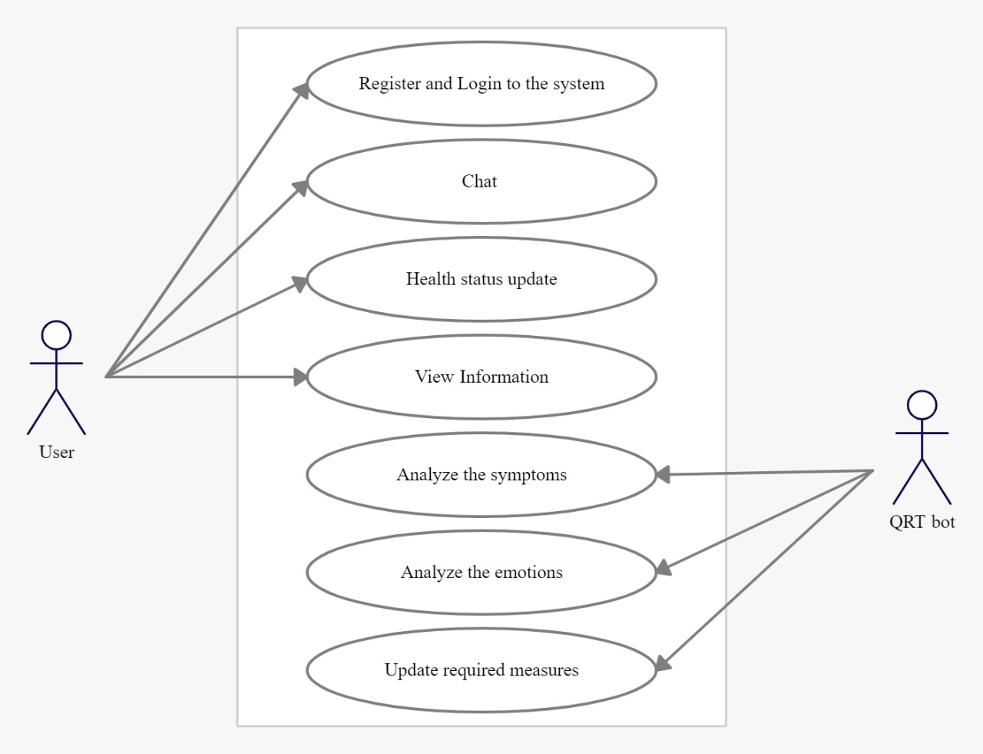
UML Diagram

Slide 11
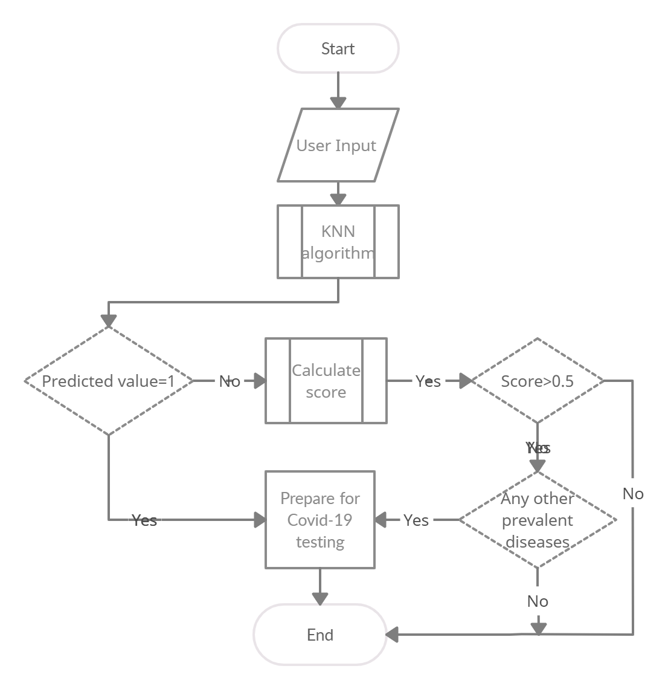
Implementation
Flowchart
1) Covid Symptom
Analysis

Slide 12
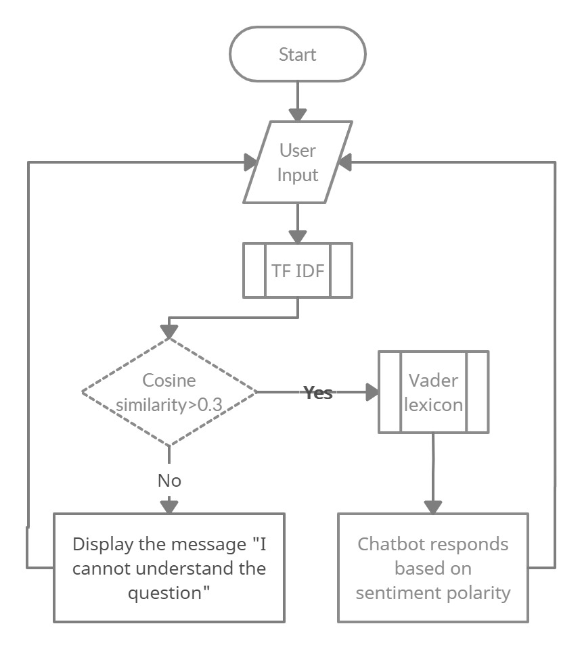
2) Emotion Analysis

Slide 13
Implementation
User registers on chatbot application. They need to submit some personal details and health details.
The chatbot allows user to login to the system
From the symptoms identified by the user, chatbot predicts whether he has to do the Covid testing or not
Chatbot recognizes users emotions through his chat replies and act accordingly.

Slide 14
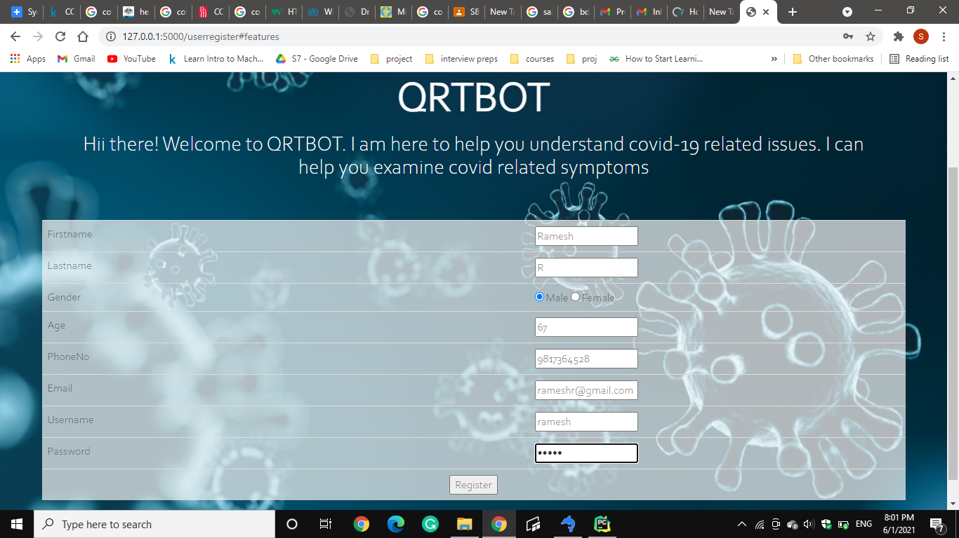
Registration Page

Slide 15
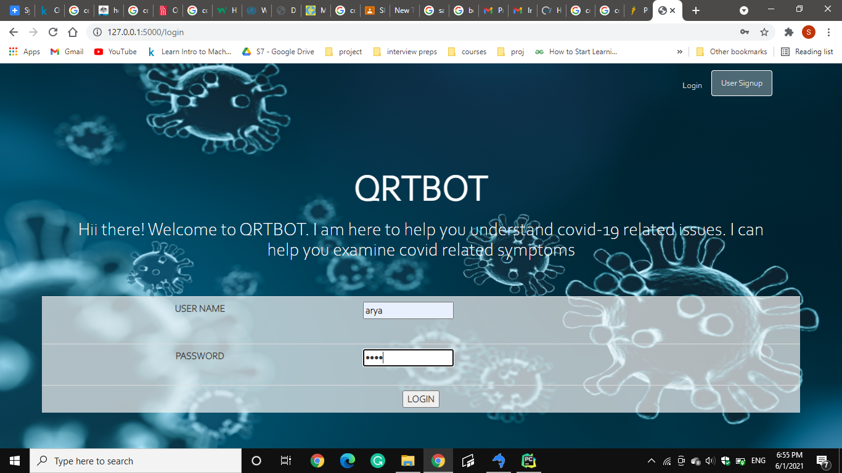
Login Page

Slide 16
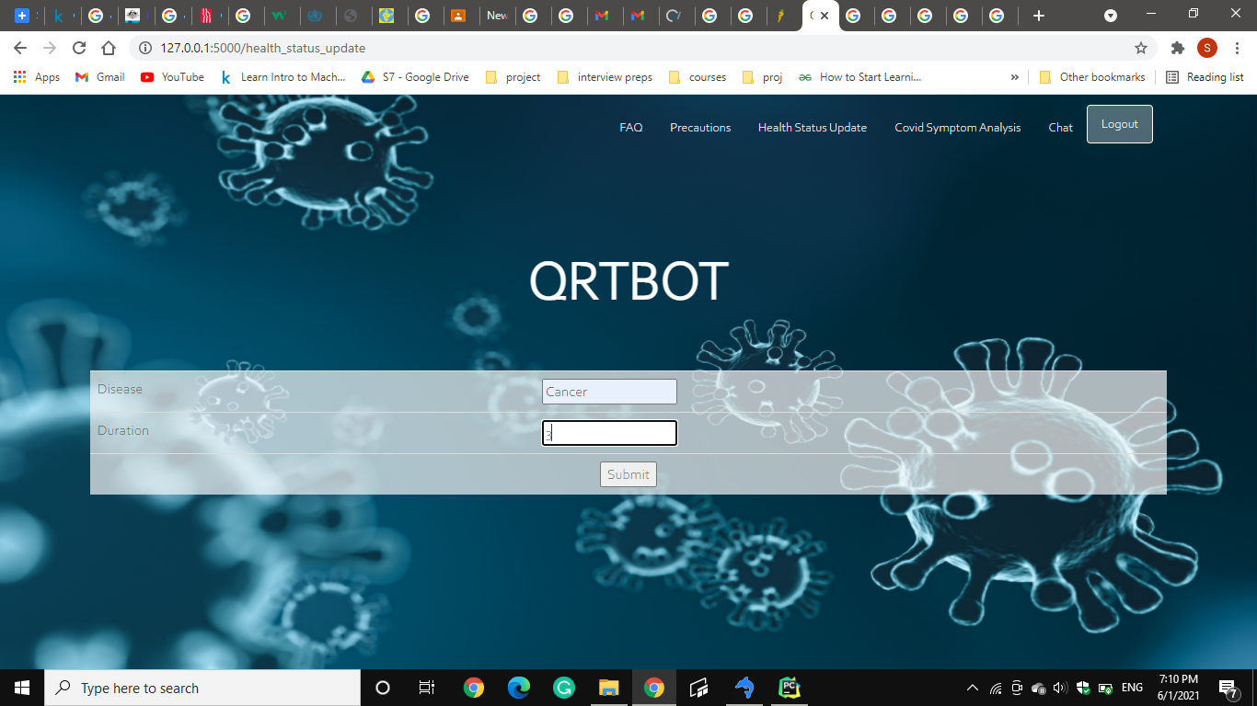
Health Status Update

Slide 17
Symptom Prediction
We use K-nearest neighbor algorithm (KNN) for Symptom Prediction
KNN identifies the symptoms from the interaction with the user
Split the dataset into training and test sets with 80-20 ratio
An accuracy of 91% was obtained for the trained model after it was tested on the test dataset.

Slide 18
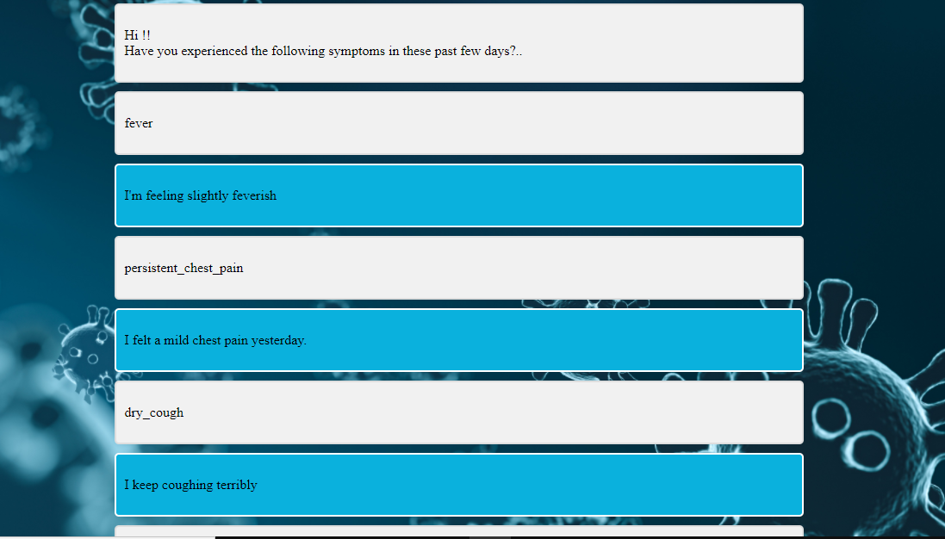

Slide 19
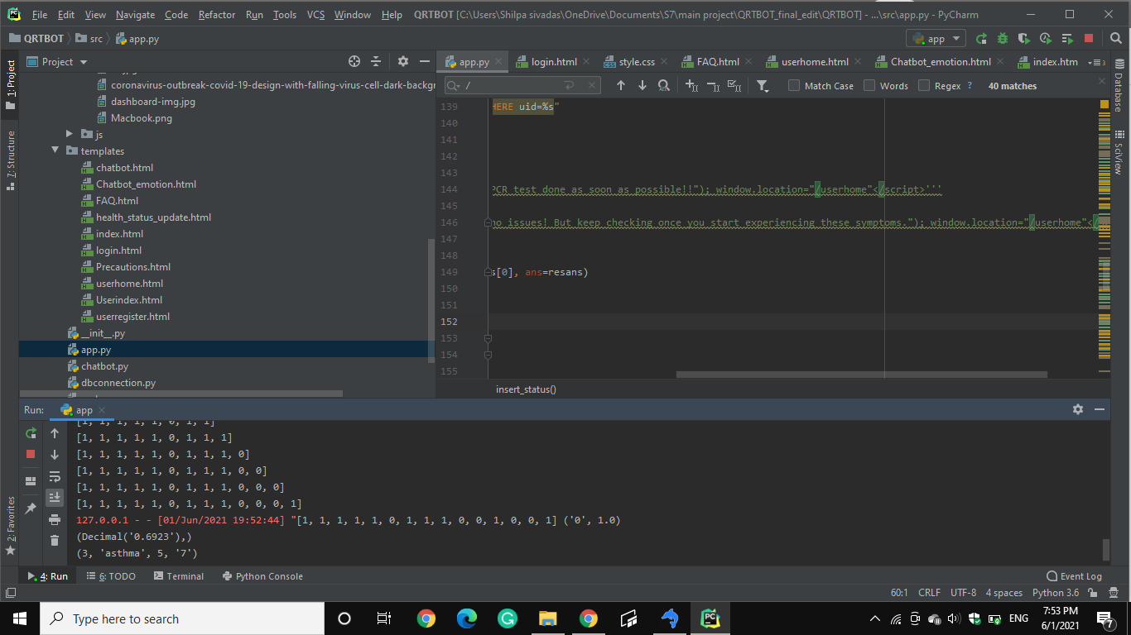
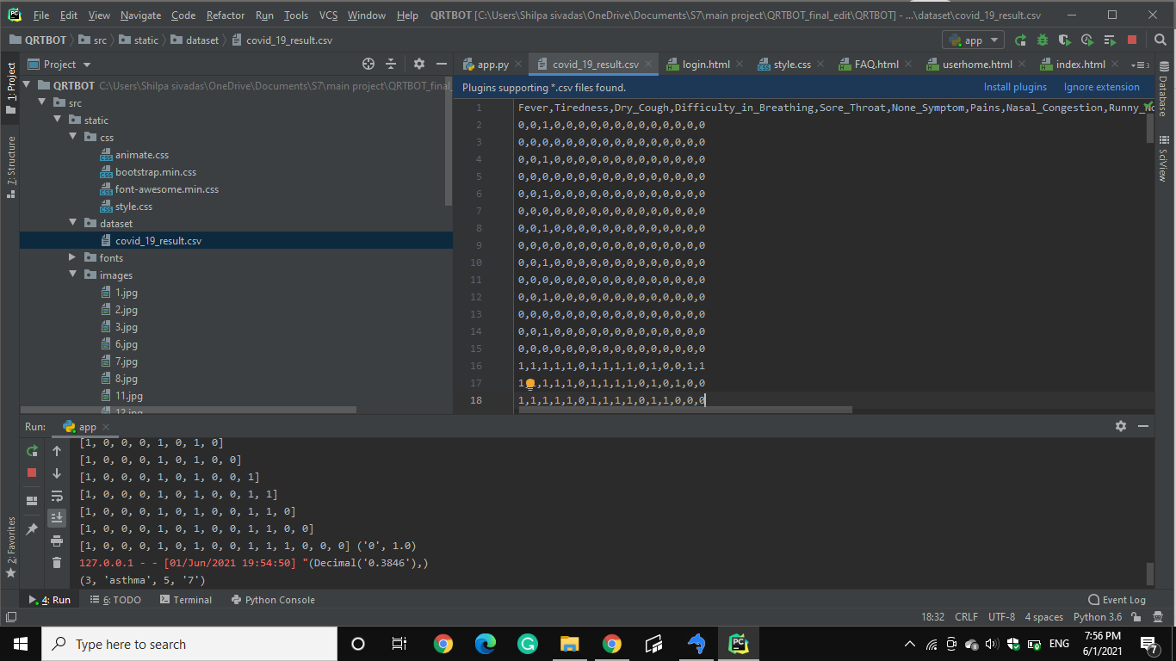
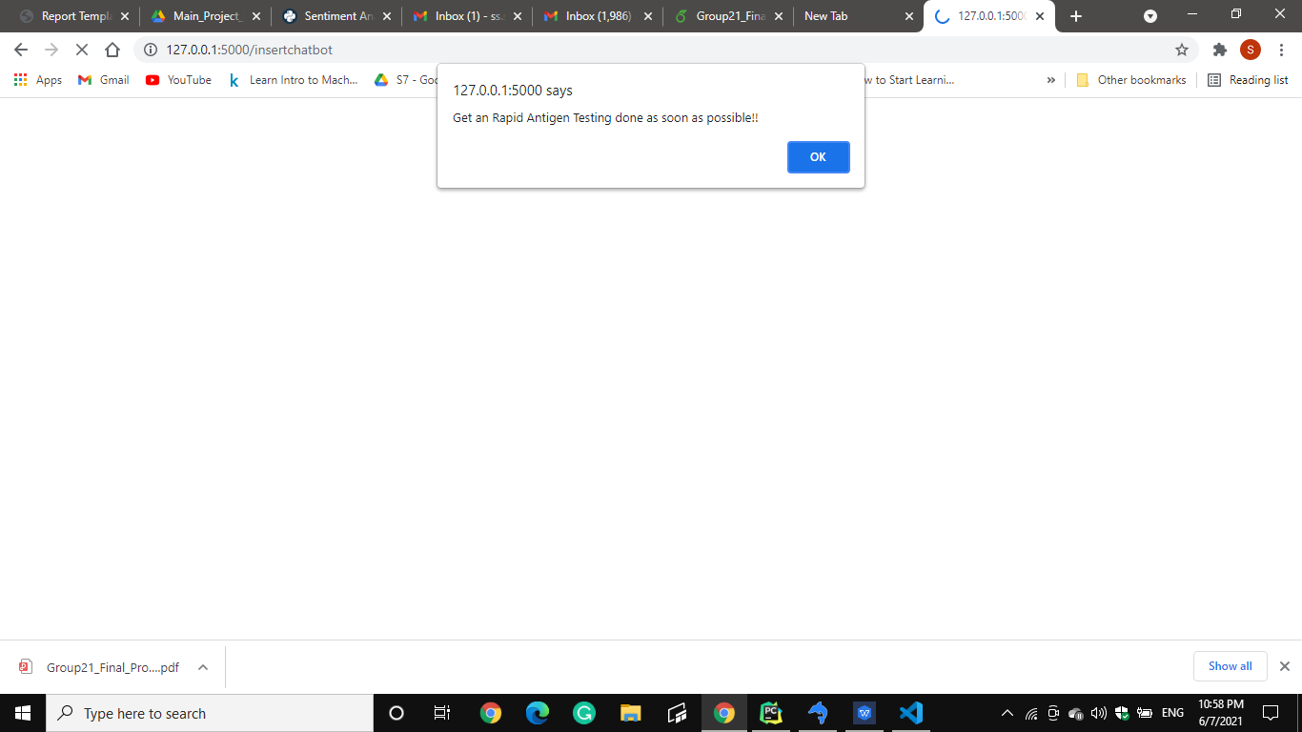
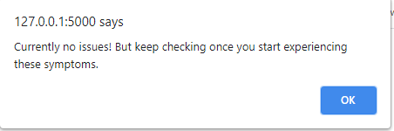

Slide 20
Emotion Analysis
We use Term Frequency-Inverse Document Frequency(TF-IDF) for emotion analysis
The words are converted to vectors and Sentence matching is done using TF-IDF
If the cosine similarity is greater than 0.3 the sentence is similar to the one in the dataset else not
The emotion in the sentence is then analysed using VADER

Slide 21
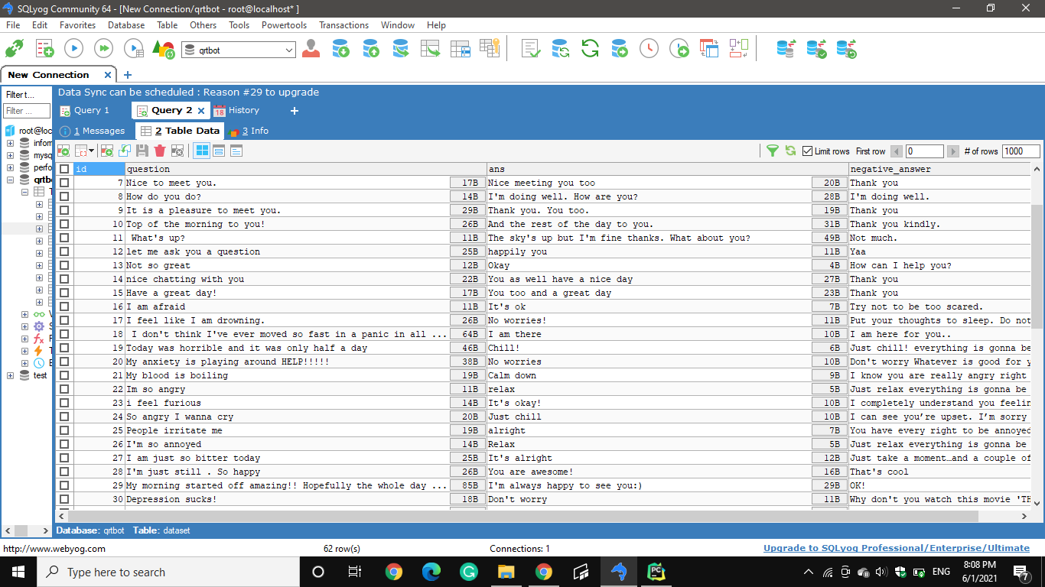

Slide 22
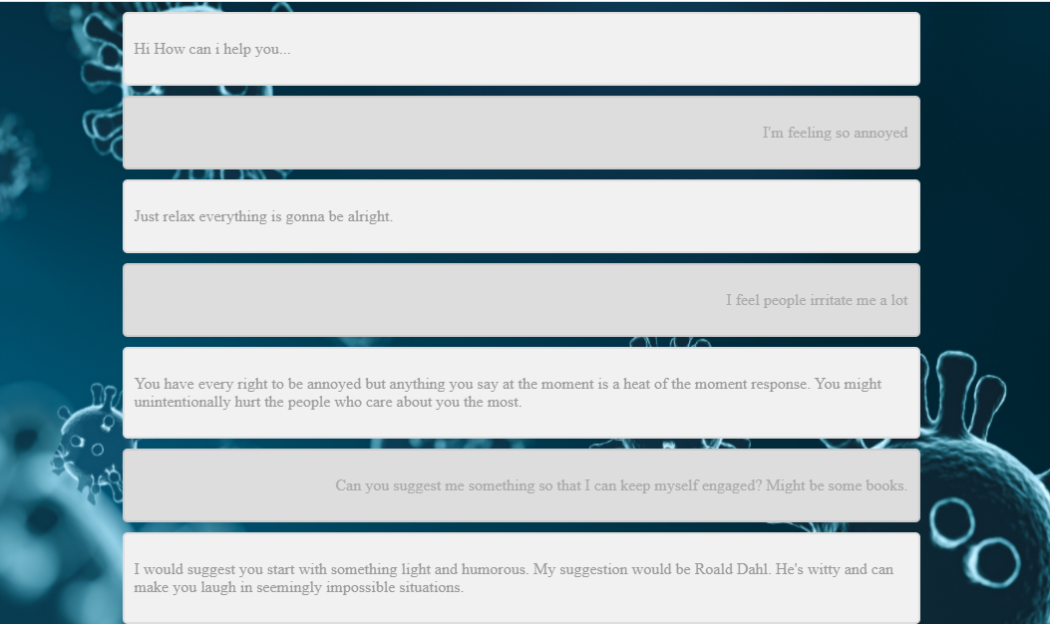

Slide 23
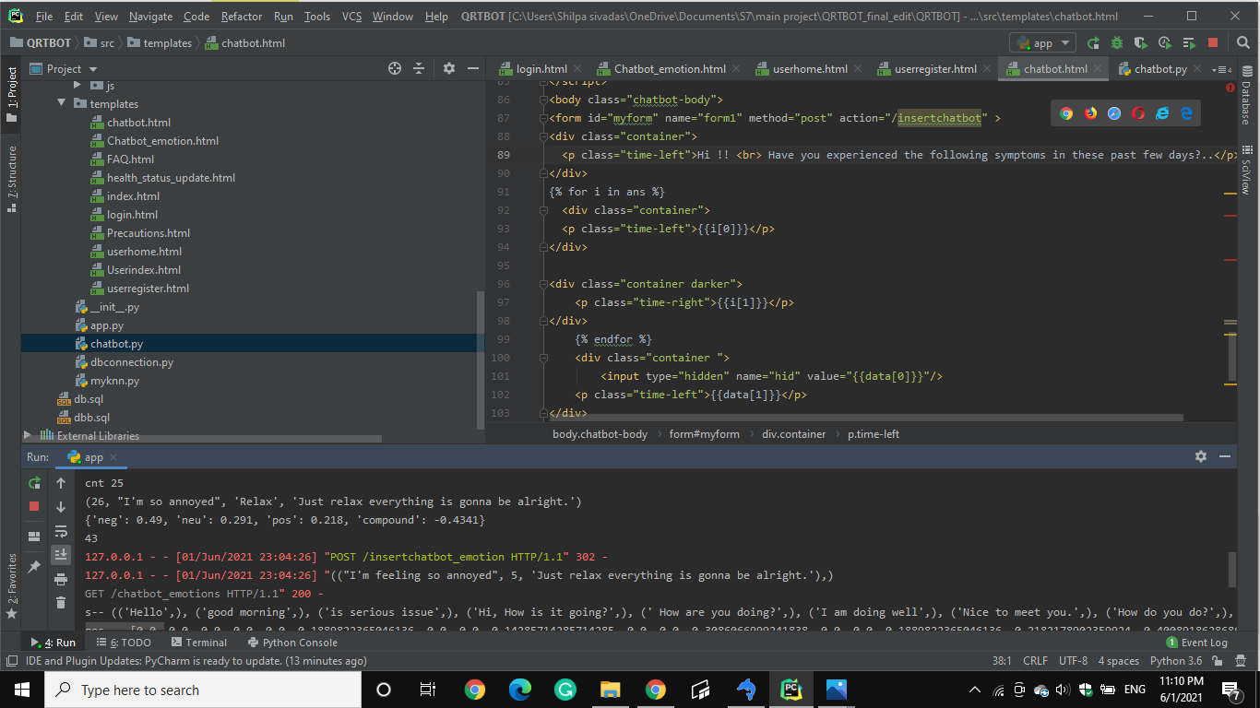
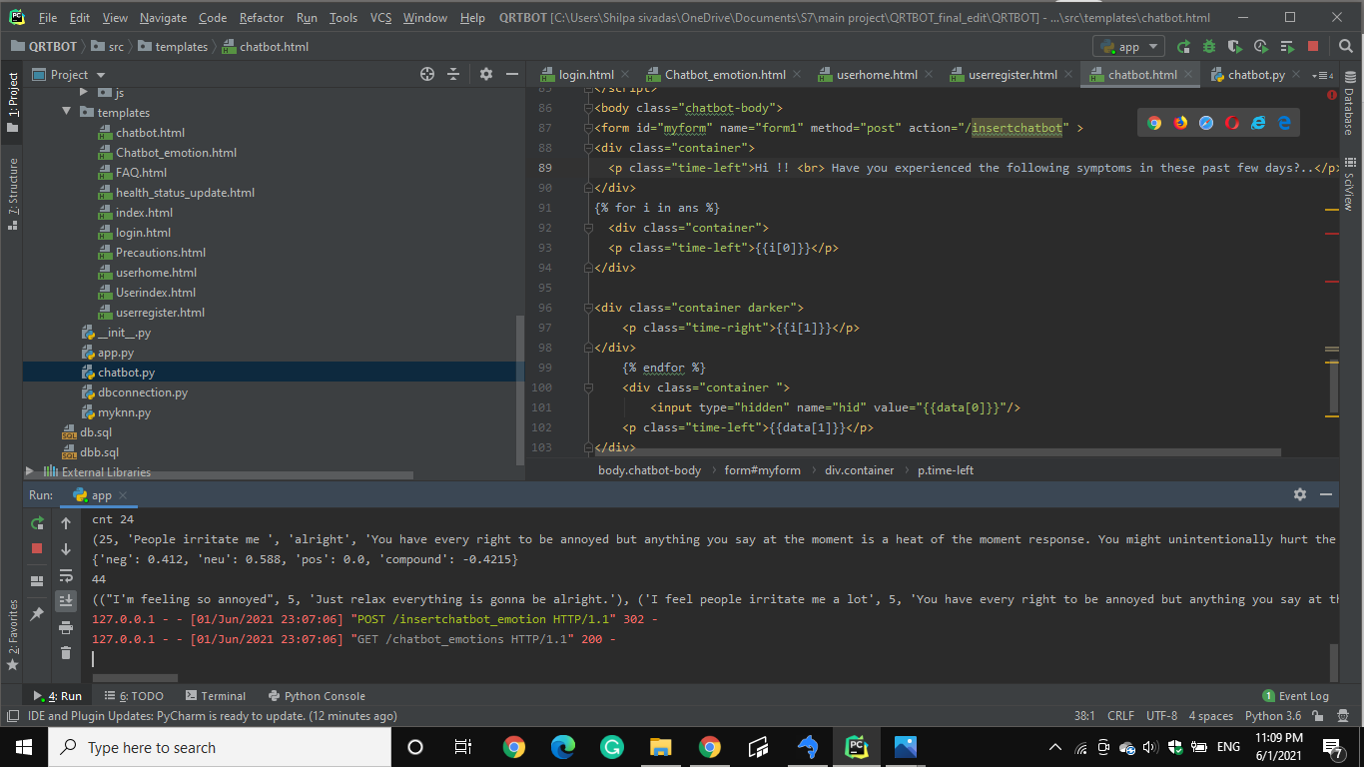
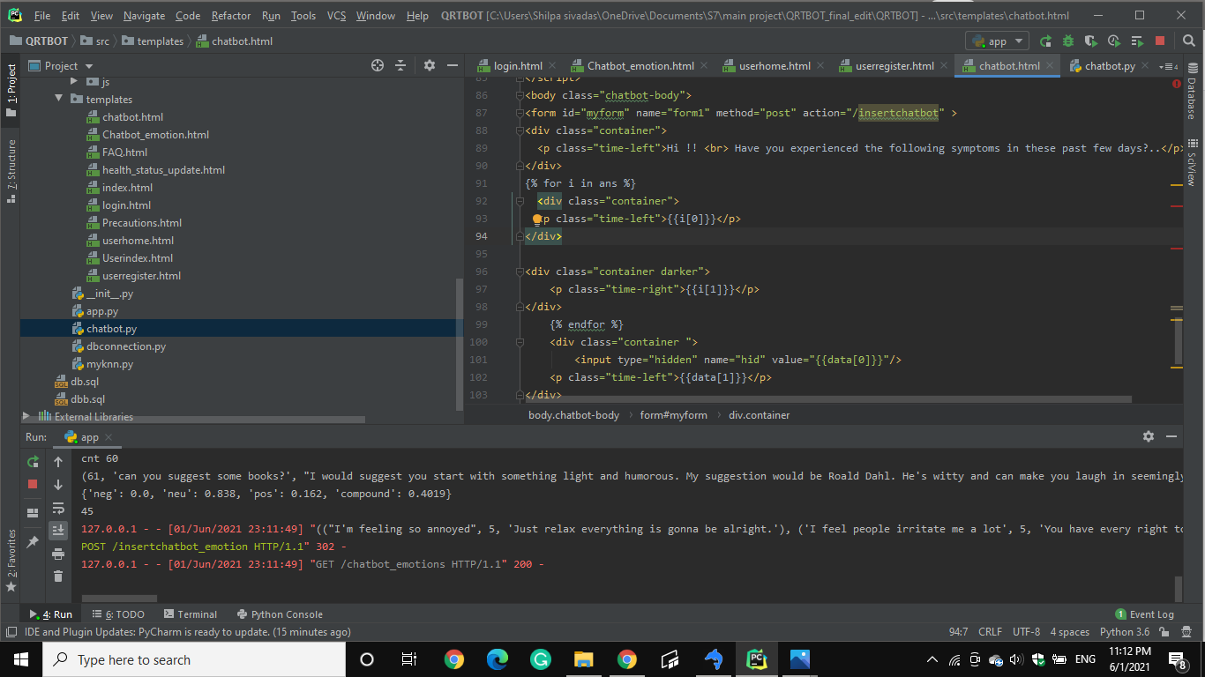
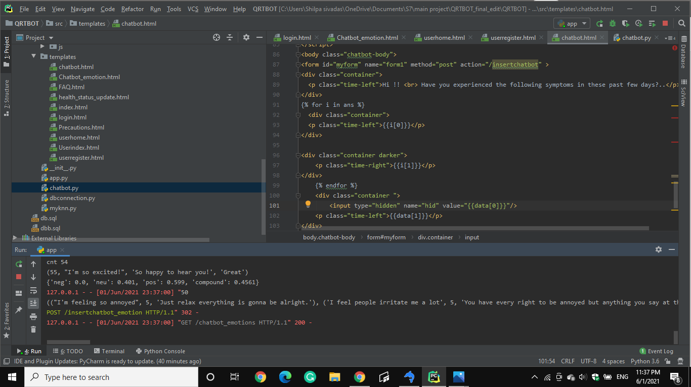

Slide 24
Application
Website that anybody can visit, regardless of device
Can see clear, objective facts about COVID-19
Users can chat with chatbot and get mental relief.

Slide 25
Conclusion
Easy-to-access website with all functionality
Inform people of best practices to battle COVID-19
Can reduce strain on hospitals.

Slide 26
Future Work
Based on user’s location, notify them the nearest test centers
Informs user the availability of vaccine in nearby health centers or hospitals.

Slide 27
References
Mathew, Rohit Binu, et al. "Chatbot for Disease Prediction and Treatment Recommendation using Machine Learning" , 2019 3rd International Conference on Trends in Electronics and Informatics (ICOEI). IEEE, 2019o
Khadikar, Sunath and Sharma, Pawan and Paygude, Priyankatinal, “Compassion Driven Conversational Chatbot Aimed for better Mental Health”, Zeichen Journal Volume 6, Issue 9, 2020
Adam S. Miner ,Liliana Laranjo and A. Baki Kocaballi, "Chatbots in the fight against the COVID-19 pandemic" npj Digital Medicine (2020) 3:65 ;
Bharti, Urmil and Bajaj, Deepali and Batra, Hunar and Lalit, Shreya and Lalit, Shweta and Gangwani, Aayushi, “Medbot: Conversational artificial intelligence powered chatbot for delivering tele-health after covid-19”,2020 5th International Conference on Communication and Electronics Systems (ICCES)

Slide 28
Thank You

